Slide 1
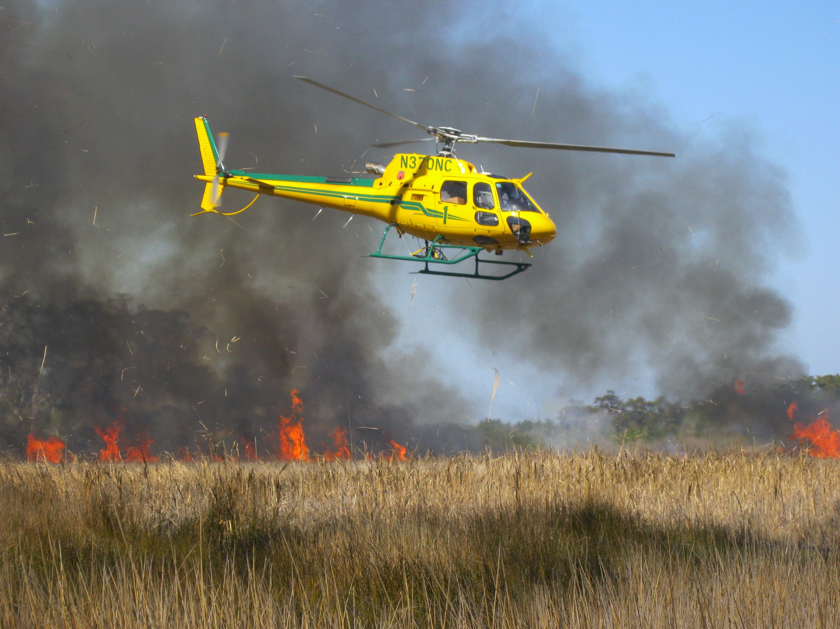


North Carolina Disasters and Ecological Forecasting Tutorial
NASA DEVELOP Program, Summer 2012
Ande Ehlen (Team Lead)
Andrea Beale
Beth Brumbaugh
Anthony Gaudino
Ryan Green
Ryan Johansen
Rachael Maingot
Amanda Taylor

Slide 2
Table of Contents
Landsat Data
Reverb Data
EarthExplorer Data
Basic ArcGIS Tools
Atmospheric Correction Model
Creating an NDVI
Creating an NDMI
Creating an NMDI
Creating a dNBR
Calculating NBRs and dNBRs
Creating an RdNBR
Creating Fire Risk Maps
Soil Type
Fuel Cover
Proximity to Roads
Slope
Wildlife Urban Interface (WUI)
Overlay Variables
Evaluating Pre- and Post- Fuel Load

Slide 3
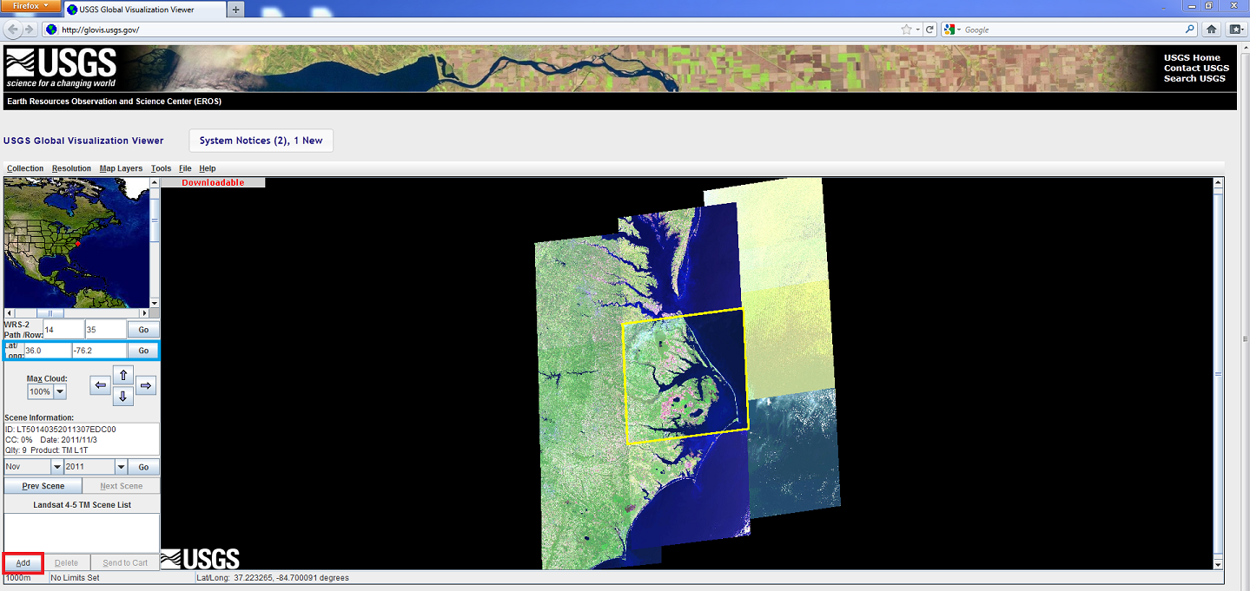
Obtaining Landsat Data from USGS Global Visualization Viewer (GloVis)
To access GloVis data, navigate to: http://www.glovis.usgs.gov/
Go to Collection in the upper left hand corner and choose the satellite you wish to use; we chose Landsat 4-5 TM
In the left panel, input the latitude and longitude coordinates for your study area and click GO, and update the month and year and click GO
Use the screen to preview the image and click Add in the lower left hand corner to add data to cart

Slide 4
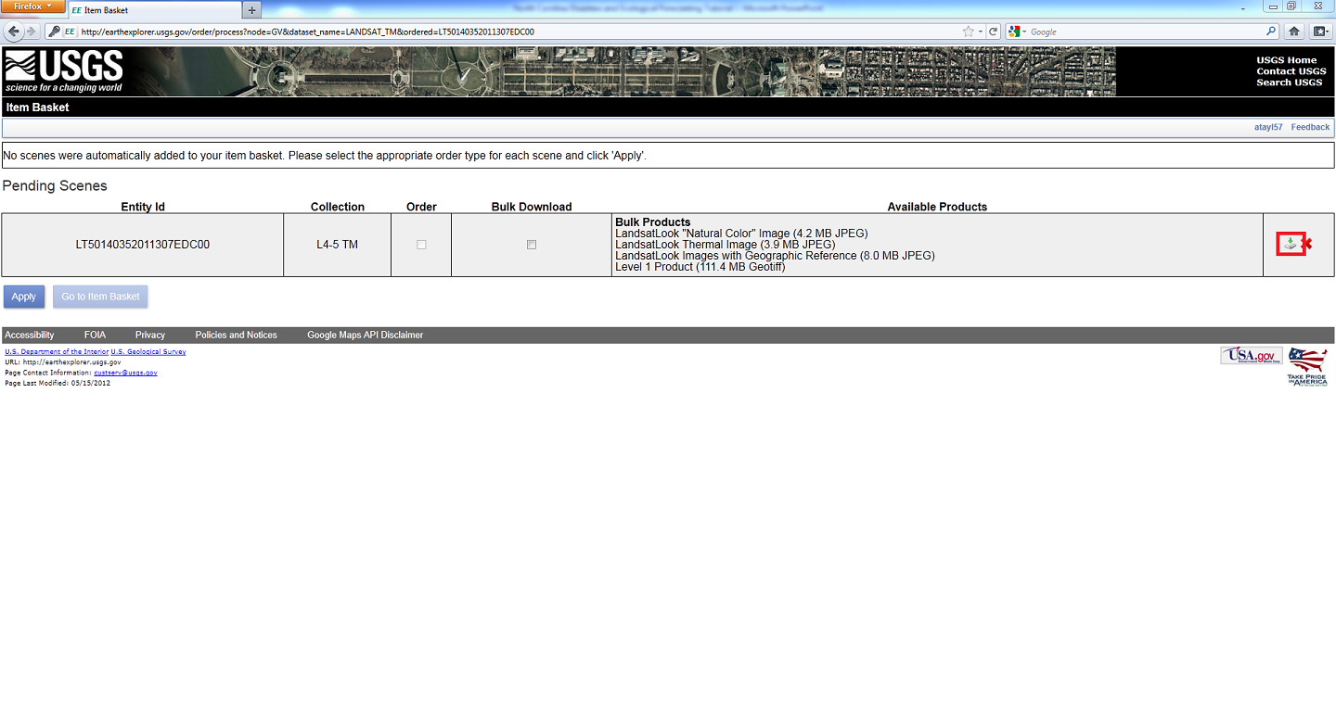
When all of the desired images are obtained, click Send to Cart. You will then need to register for an account with USGS by creating a Username and Password.
Then, select the download icon and select your product (Level 1) and extract your data using 7-Zip (or a similar program).
**Not all images have been processed as a Level 1 product to be downloaded immediately. Therefore, you will have to order the data free of charge, and it will be delivered within 2-3 days.

Slide 5
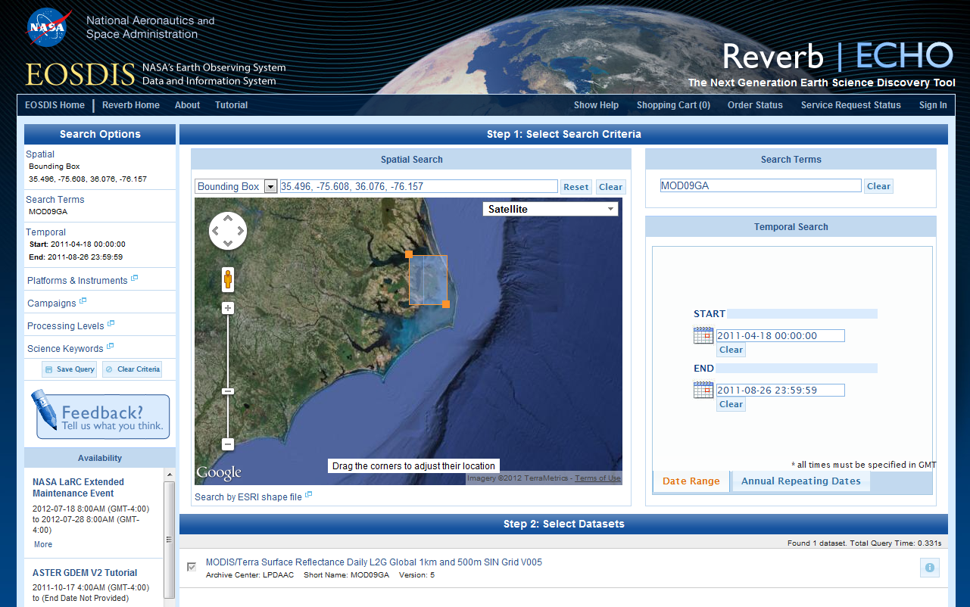
Reverb
To access Reverb data, navigate to: http://reverb.echo.nasa.gov/
Draw or type in the coordinates of the Bounding Box for your area of interest
In Search Terms, type in the product you would like to download
For this project, we used MOD09GA and MYD09GA which is the 500m Daily Surface Reflectance product for both Terra and Aqua
We also used MOD44W which is the MODIS Land Water Mask Derived 250m product
You can research all ASTER and MODIS products at the following site to find the images you need:
https://lpdaac.usgs.gov/products
Click the Start and End
Dates that apply to
your study
Click the Dataset under
Step 2: Select Datasets

Slide 6
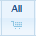
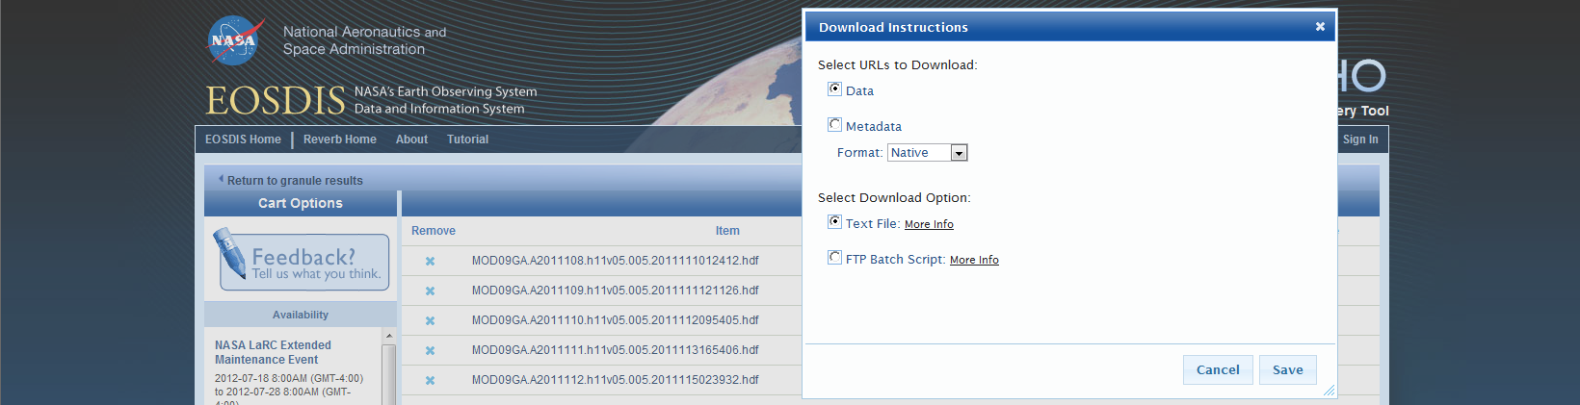
The box under Step 3: Discover Granules should be automatically checked. If not, check all the granules that apply
Then, click Search for Granules. And error message may pop up, press OK.
Note: this error message is informing you of an data error issue that some MODIS products had for selected years. Please read the error the message and research the error dates to make sure your dates do not coincide (or at least understand the error it will produce with your imagery.
Click on the name of the product. If all the granules present are the ones to be included in the study, then click the All Cart symbol. If not, then individually select each image with the corresponding Cart symbol. Once completed, click View Items in Cart.
At the bottom of the shopping cart page, click Download.
Then, select the URL to Download as Data and Select Download Option as Text File. Click Save.
If you know how to run an FTP batch script, then that option would be quickest.
Open the text file and copy and paste the .hdf link into a new Internet Explorer Window. After it downloads, save it to a folder on your PC.

Slide 7
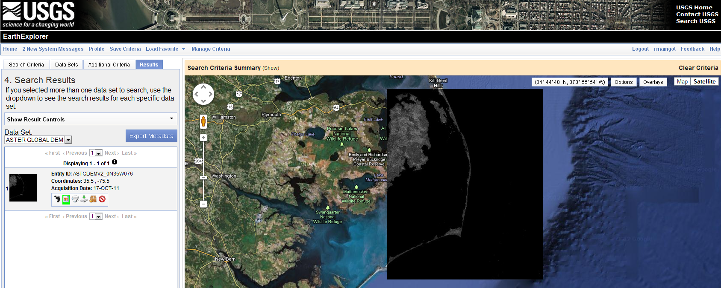
EarthExplorer
To access EarthExplorer data, navigate to: http://earthexplorer.usgs.gov/
Under Search Criteria, type in the name of the study area and press Enter. Ex: Pains Bays, NC. Click your study area when it pops up below the search bar.
Specify the date range of your search.
Under the Data Sets tab, check the data sets that you would like to download
For this study, we selected the ASTER GLOBAL DEM under the Digital Elevation heading
Under Results, the image(s) will be displayed. To see a preview, select the Show Browse Overlay symbol

Slide 8
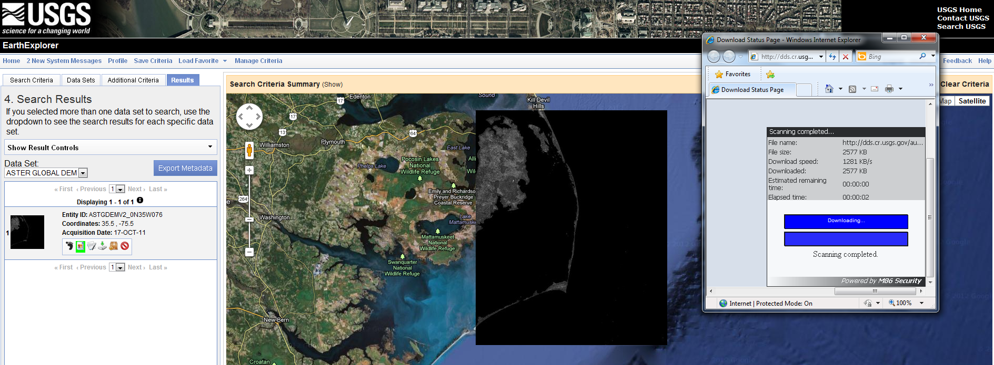
Click the download icon for each image you would like. EarthExplorer will ask you to Login to your free account.
The ASTER product has a user agreement. Read the agreement, check the box to say you agree with the terms, and click Download
This will redirect to another site to download the data. Save to your PC.

Slide 9
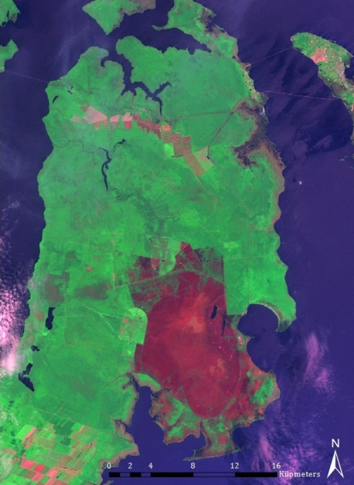
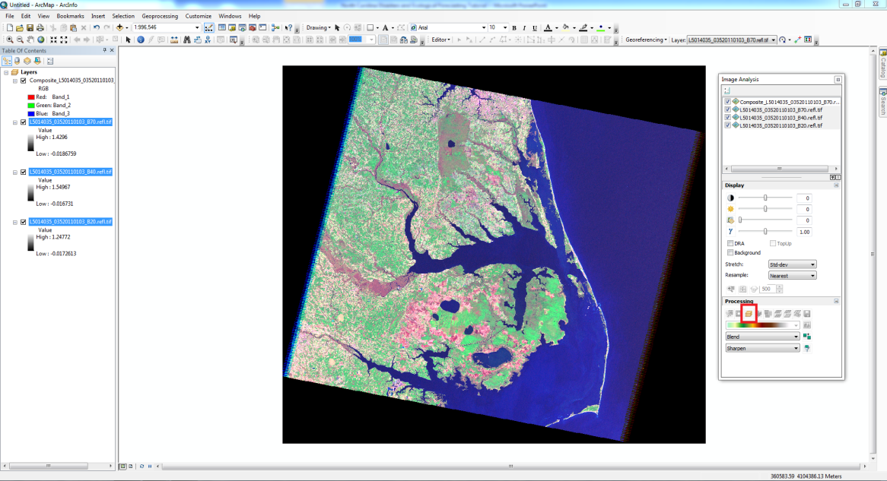
Basic ArcGIS Tools
Compositing Bands
Open ArcMap 10 and select the Add Data button
Add the bands you want to composite, and once ArcMap is finished loading the bands, they will open
To composite the bands select Windows -> Image Analysis
In the Image Analysis window, select all of the bands you wish to composite and press the Composite Bands button near the bottom of the page
ArcMap will create and display the map once it is finished processing
For information on band combinations, visit: http://web.pdx.edu/~emch/ip1/bandcombinations.html
Combination of Landsat 5 TM bands 7-4-2 to show burn scar of Pains Bay fire

Slide 10
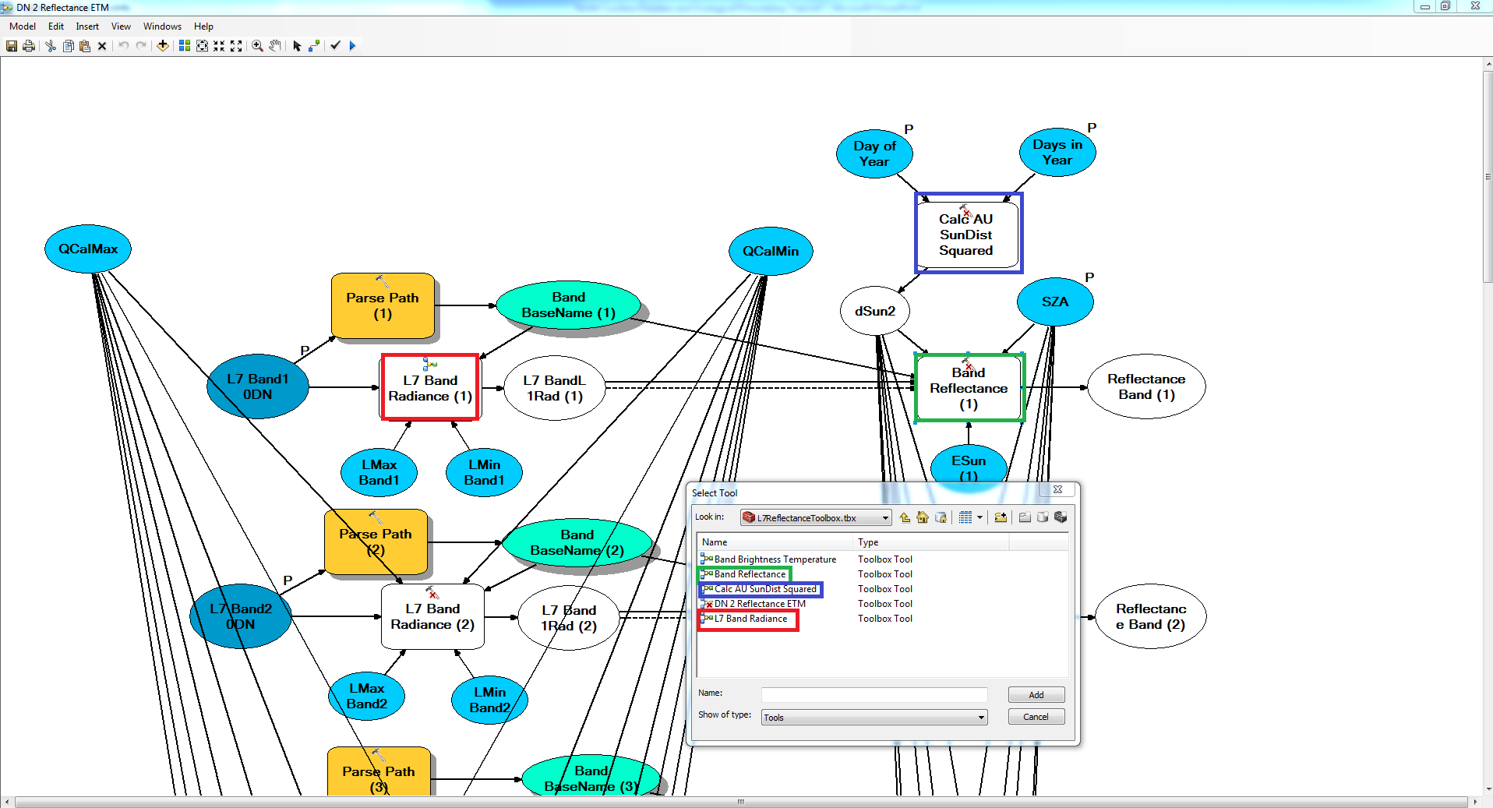
Atmospheric Correction Model
Using the Toolbox sent via email, bands can be converted from Digital Numbers (DN) to Reflectance values, which are used to create composite bands, NDVIs, and NDMIs.
Add the Toolbox by clicking Geoprocessing on the top toolbar > ArcToolbox > Right-click on “ArcToolbox” > Add Toolbox
To edit the model for use, right click “DN 2 Reflectance ETM” and click Edit. The model should open in a new window.
Before running the model, double-click on the Band Radiance box and connect Band Radiance Model from the toolbox. Repeat for all seven Band Radiance boxes in model.
Double-click Band Reflectance box and connect Band Reflectance Model. Repeat for bands 2-5 and band 7. Connect the Band Brightness Temperature Model to the Band 6 Reflectance box.
Double-click Calc AU SunDist Squared box and connect Calc SunDist Squared Model.
Note: These steps should only have to be done the first time the model is run, as the connections should save.

Slide 11
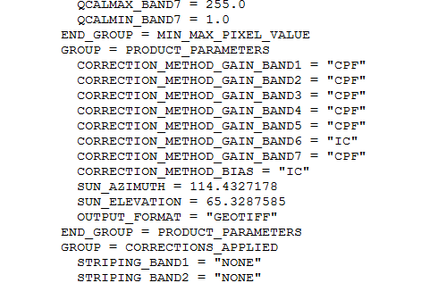
4. Double-click the Band 1 circle and connect Band 1 of your uncorrected image to it. Repeat for Bands 2-7.
5. To save the Radiance and Reflectance Bands for later use, double-click the BandL 1Rad circle and redirect the path to save to your desktop. Also double-click the Reflectance Band circle and redirect the path to save to your desktop. Repeat for Bands 2-7.
6. Day of the Year, QCalMin, QCalMax, LMax, LMin, and SZA (Sun Zenith Angle) can all be determined from the Metadata that came from the Level 1 Product.
Day of the Year refers to the Julian date (a number from 1-366).
SZA = 90° – sun elevation
ESun values for Bands 1-5 and 7 and K values for Band 6 can be found in the “Landsat Calibration Summary” attached to the email the model came with.
All boxes should be colored in. Click the check mark button at the top of the screen to verify that everything is correct, and then click the Run button right next to the check mark.
Once it is finished running, the corrected bands are available for use.
Notes:
**DAYS IN YEAR

Slide 12
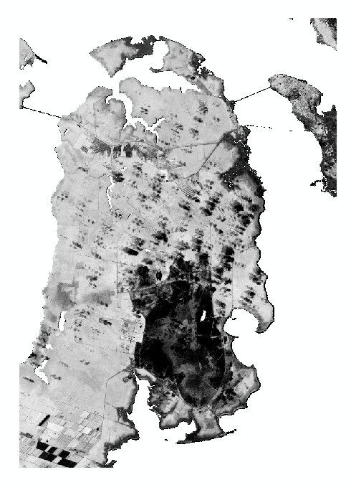
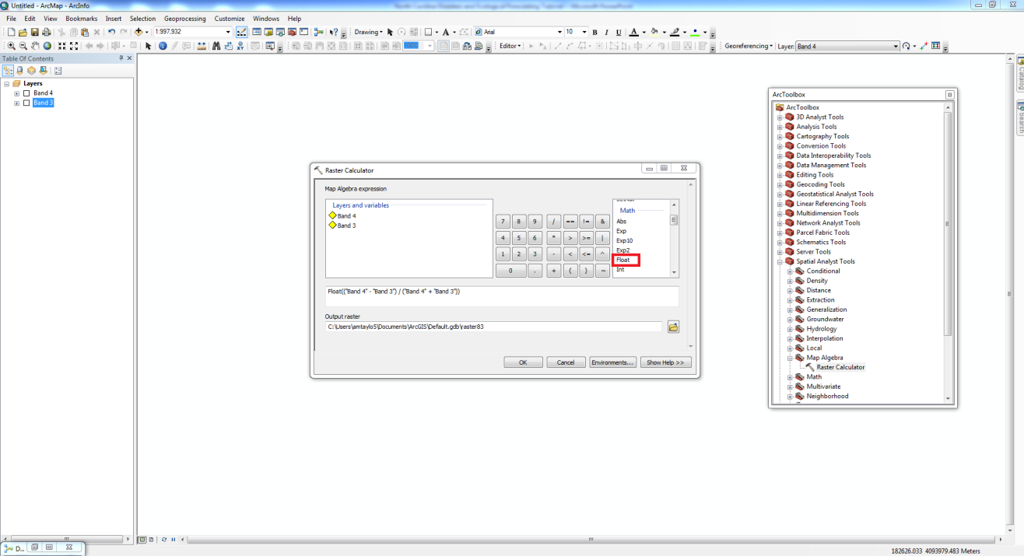
Normalized Difference Vegetation Index (NDVI)
Open ArcMap 10 and select the Add Data button
Add reflectance bands 3 and 4 to ArcMap and click the toolbox icon
Once in the toolbox window, click Spatial Analyst -> Map Algebra -> Raster Calculator
In the Raster Calculator, double-click Float and input the following equation:
(Band 4 - Band 3)/(Band 4 + Band 3)
Save the output file and click OK; once ArcMap is finished processing, the map will appear.
Mid-fire NDVI for Pains Bay

Slide 13
Normalized difference Moisture Index (NDMI)
Open ArcMap 10 and select the Add Data button
Add reflectance bands 4 and 5 to ArcMap and click the toolbox icon
Once in the toolbox window click Spatial Analyst -> Map Algebra -> Raster Calculator
In the Raster Calculator, double-click Float and input the following equation:
(Band 4 - Band 5)/(Band 4 + Band 5)
Save the output file and click OK; once ArcMap is finished processing, the map will appear.
You may change the color ramp to easier view/display
changes in values
NDMI for Juniper Road fire

Slide 14
Normalized Multi-band Drought Index (NMDI)
Provided with the deliverables are four Model Builder models that will automate analyzing multiple MODIS images (MOD09GA/MYD09GA) to create NMDIs.
Below is the suggested Folder structure to analyze the images.
All folder names must have no spaces or punctuation (other than an underscore).
Also, it is highly recommended to have the images saved in two places:
A folder where the original images can be accessed if the processed images become corrupted or misprocessed (ex: Original)
A folder that contain the images that will be processed (ex: Processed).
Original
Processed
NMDI
Masked
Area1
Area2
Area…
The folders listed as Area1, Area2, etc. can be renamed to the name of the study area. For example: PainsBayFire, JuniperRoadFire, etc.
The NMDI model has four parts: Model_iterate1, Model_iterate2, Model_iterate3, and Model_iterate4. These parts should be run in order (i.e. 1, 2, 3, 4.)

Slide 15
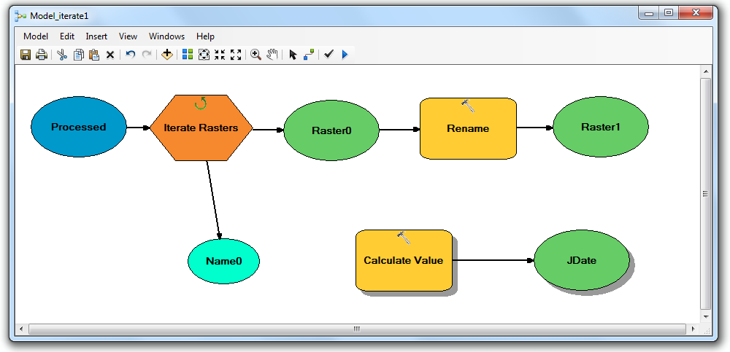
NMDI Model_iterate1: Renaming the HDF Files to the Julian Date
First, make sure all the HDF files you downloaded are in both the Original and Processed file folders.
In ArcMap, open ArcToolbox by going to menu bar: Geoprocessing→ArcToolbox.
Right click the ArcToolbox heading in the toolbox and click Add Toolbox.
Navigate to the toolbox provided with this project called NMDIToolbox.tbx.
Once added, navigate to the toolbox called NMDIToolbox towards the middle of the list in ArcToolbox and click expand to open view each model.
Right click Model_iterate1 and click Edit to open the model in Model Builder.
Double click Iterate Rasters tool.
Under Workspace or Raster Catalog, navigate to the Processed folder.
Make sure Wildcard is blank, Raster Format is HDF, and Recursive is unchecked. Click OK.
Double click Rename tool. Make sure the Output data element is navigated to the Processed folder and that the file name is %JDate%.hdf
Click OK.
In the tool bar: click Save , followed by Validate Entire Model , and concluding with Run .
Note: If you would like the Julian Date to include the year, change the Expression in the Calculate Value tool to "%Name0%"[9:16]

Slide 16
NMDI Model_iterate2: Creating NMDIs for each Julian Date
In the NMDIToolbox, right click Model_iterate2 and click Edit to open the model in Model Builder.
Double click Iterate Rasters tool.
Under Workspace or Raster Catalog, navigate to the Processed folder.
Make sure Wildcard is blank, Raster Format is blank, and Recursive is unchecked. Click OK.
Double click the first Extract Subdataset tool.
Navigate Output Raster to the Processed folder, and maintain the image name as its default, i.e. 2.tif, 6.tif, and 7.tif.
Example of output raster name: C:\Desktop\Processed\2.tif.
Repeat for all 3 Extract Subdataset tools.
Double click the first Raster Calculator tool.
Navigate Output Raster to the Processed folder, and maintain the image name as its default, i.e. Band2_4, etc. Example of output raster name: C:\Desktop\Processed\Band2_4.
All equations should look like: Float(0.0001 *"%Band2_3%"), which the band name changing per line (i.e. Band6_3 & Band7_3).
Repeat for 3 Raster Calculator tools, #1-3 (not the final Raster Calculator).
Double click the first Project Raster tool.
Navigate Output Raster to the Processed folder, and maintain the image name as its default, i.e. Band2_5, etc. Example of output raster name: C:\Desktop\Processed\Band2_5.
Make sure the Output Coordinate System is projected to a local projection for your study area. Ex: WGS 1984 UTM Zone 18N.
Repeat for 3 Project Raster tools.
Double click the final Raster Calculator tool (#4).
Navigate Output Raster to the NMDI folder within the Processed folder, and maintain the image name as its default: %Name1%.tif
Make sure the equation looks like: Float((("%Band2_5%") - ("%Band6_5%" - "%Band7_5%")) / ("%Band2_5%" + ("%Band6_5%" - "%Band7_5%")))
Save, Validate, and Run the model.
Note: See next slide for image of the model.

Slide 17
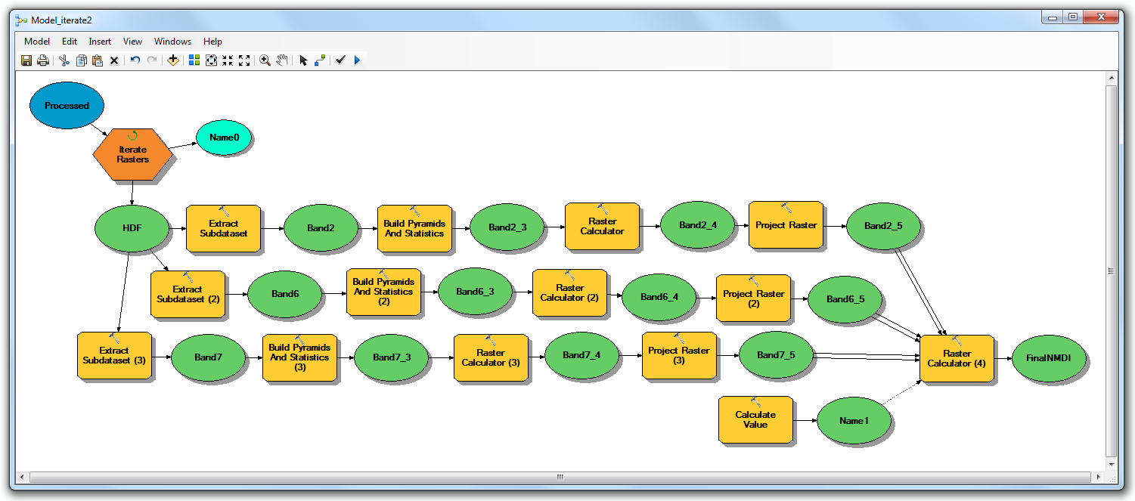
NMDI Model_iterate2: Creating NMDIs for each Julian Date

Slide 18
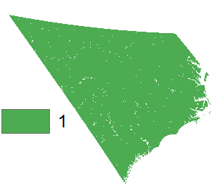
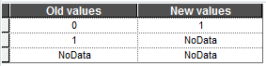
NMDI Model_iterate3: Isolating Land Values and Eliminating the Water Values
Before Model_Iterator3 can be used, a land/water mask must be created using MOD44W product (or another mask source of choice).
Download the MOD44W tile for every tile used for the study area. For example, this study uses one MODIS tile, h11v05. Open the HDF file in ArcMap and select option 0 [zero] when prompted.
If the image is not displayed, double click the layer name in the Table of Contents to open the Properties window, go to the Symbology tab, and set the stretch as Minimum-Maximum to compute the histogram, then click OK.
In ArcMap, search for tools by going to menu bar: Geoprocessing→Search For Tools.
Type Raster to Other Format, click to open the tool.
Input the HDF, save the Output Workspace to your workspace, and select the Raster Format to TIFF. Click OK.
In the Search For Tools window, type in Project Raster and click the tool to open.
Put the new coordinate as the appropriate UTM zone.
Save the raster to the appropriate folder as a Tiff image (i.e. “MOD44W_proj.tif”).
Use the drop down arrow to select the default Geographic Transformation.
Lastly, set the Output Cell Size to 464.
Next, reclassify the new projected raster using the Reclassify tool.
Set Input Raster is the projected layer (i.e. “MOD44W_proj.tif”), and the Reclass Field is Value.
Click the Unique button, and fill the table as the table to the below.
Set the Output Raster as Mask.tif.
Remove all previous rasters from ArcMap (i.e. only keep Mask.tif in ArcMap).
Note: the mask file must be open in ArcMap in order for the Model_iterate3 to work.
Note: To get the same visual as the image to the right, change the coordinate system of Layers to the same as the UTM projection.

Slide 19
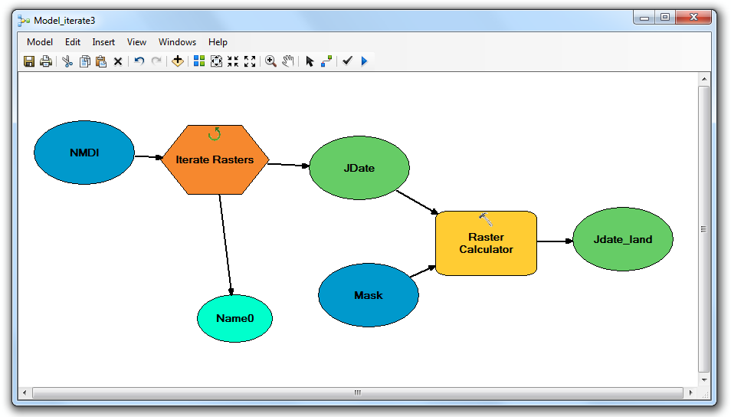
NMDI Model_iterate3: Isolating Land Values and Eliminating the Water Values
In the NMDIToolbox, right click Model_iterate3 and click Edit to open the model in Model Builder.
Double click Iterate Rasters tool.
Under Workspace or Raster Catalog, navigate to the NMDI folder within the Processed folder.
Make sure Wildcard is blank, Raster Format is blank, and Recursive is unchecked. Click OK.
Double click the first Raster Calculator tool.
The equation should look like this: Float("%JDate%" *"Mask")
Make sure the Mask in the above equation is added to the equation by double clicking the yellow Mask icon from the Layers and Variables window.
The Output Raster should be navigating to the Masked folder within the NMDI folder. The layer name still remain %Name0%. For example: C:\Desktop\Processed\NMDI\Masked\%Name0%
Save, Validate, and Run the model.

Slide 20
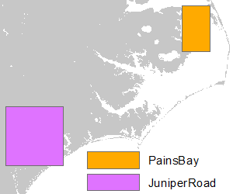
NMDI Model_iterate4: Narrowing NMDI Image to Study Area(s)
Before Model_Iterator4 can be used, polygons of the study area(s) must be created.
Open ArcCatalog, and navigate to your workspace folder.
Right-click your folder where the new layer will be created, and click New→Personal Geodatabase.
Name the new geodatabase as the name of your study area. For example, PainsBay.
Remember to keep file name without spaces and punctuation (except underscore).
Right-click the new personal geodatabase just created, and click New→Feature Class.
The Name window should again be the name of the study area, for example PainsBay.
The Type should be Polygon Features. Click Next.
The coordinate system should be the same UTM zone that all the layers have been projected into. For example, for this study we used WGS 1984 UTM Zone 18N. Click Next.
Click Next again. Click Finish.
Repeat steps for all study areas needed for this study. For example, we made two for this study: PainsBay and JuniperRoad. Once completed, close ArcCatalog.
Open the new polygon feature classes in ArcMap.
In the menu bar, go to Customize→Toolbars→Editor. Drag the Editor toolbar into the menu toolbar area to make it permanent.
Click the dropdown Editor in the Editor toolbar, and click Start Editing. Click one of the new study area feature classes that you created, and click OK.
Once the Create Features window opens, click the name of the layer in this new window, and click Rectangle at the bottom.
Draw a rectangle around your study area, and double click once the polygon is of your satisfaction.
Click the dropdown Editor in the Editor toolbar, and click Save Editing. Then click Stop Editing.
Repeat Step 6 for every study area polygon created.

Slide 21
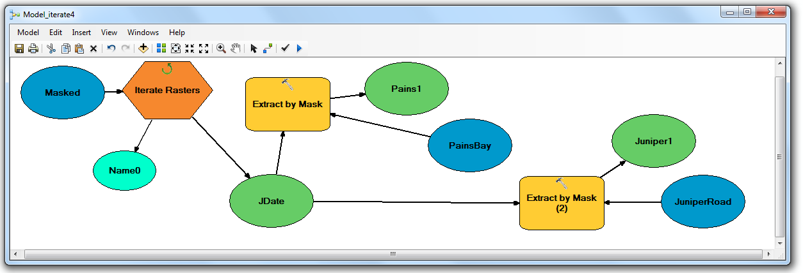
NMDI Model_iterate4: Narrowing Image to Study Area(s)
In the NMDIToolbox, right click Model_iterate4 and click Edit to open the model in Model Builder
Double click Iterate Rasters tool.
Under Workspace or Raster Catalog, navigate to the Masked folder within the NDMI folder.
Make sure Wildcard is blank, Raster Format is blank, and Recursive is unchecked. Click OK.
Each Extract by Mask tool allows you to extract our study area from the larger tile.
In this example of its use, there are 2 study areas. Add how many Extract by Mask tools as there are study areas to fit to your needs.
Double click the first Extract by Mask tool.
The Input raster should be already set to JDATE.
Click the dropdown arrow of the Input raster or feature mask data to select the first study area polygon. For example, the PainsBay yellow icon.
The Output Raster should be navigating to the first study area folder within the Masked folder. The layer name should still remain %Name0%. For example: C:\Desktop\Processed\NMDI\Masked\PainsBay\%Name0%
Repeat Step 10 for all study areas. Make sure to navigate the final images to another study area folder for each study area, for example: C:\Desktop\Processed\NMDI\Masked\JuniperRoad\%Name0%
Save, Validate, and Run the model.

Slide 22
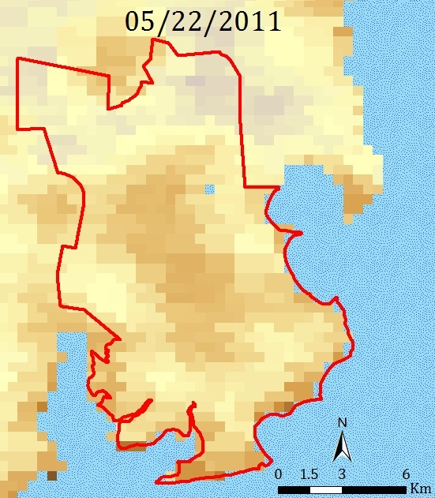
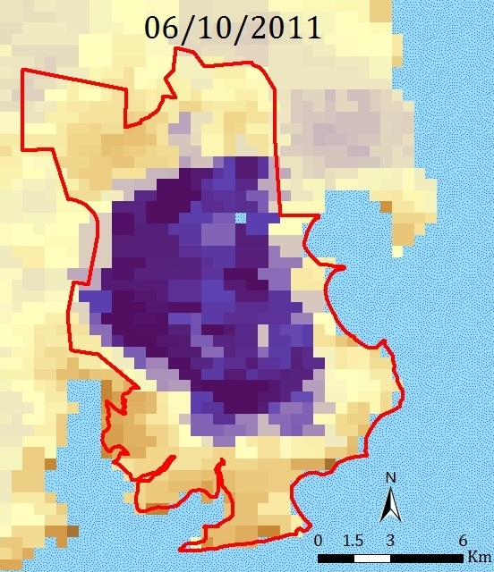
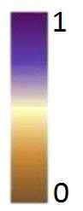
NMDI Final Processing Steps to the Images
Each image in the study area folders can now be opened into Arc and examined.
Each image should be examined for cloud and smoke contamination. For each contaminated image, the Aqua image may be able to replace the missing Terra image (or visa versa). I.e. replace the MYD09GA image for the MOD09GA image for that date. If both images are contaminated, we suggest deleting the image from the dataset.
The NMDI index tells the user two things: soil moisture and vegetation moisture.
The meanings of NMDI values (0 to 1) depend on the land cover type.
In areas of bare soil, high NMDI values mean low soil moisture and low NMDI values mean high soil moisture.
In areas of vegetation cover, high NMDI values mean high vegetation moisture and low NMDI values mean low vegetation moisture.
Please read the founding article of NMDI by Wang and Qu (2007) for more information: http://www.agu.org/pubs/crossref/2007/2007GL031021.shtml
Image A is a pre-fire image of the Pains Bay fire location (i.e. the red boundary is the final extent of the fire). At this time, the study area was completely covered by vegetation. Hence the low values represent the low vegetation moisture of the study area.
A
B
Image B is a mid-fire image of the Pains Bay fire. At this time, the study area was mostly converted to soil, non-vegetation coverage. Hence the high values represent the low soil moisture of the study area.
Notes:
Remind the user that if they mess up that they have to redo the entire process of the NMDI to get it.

Slide 23
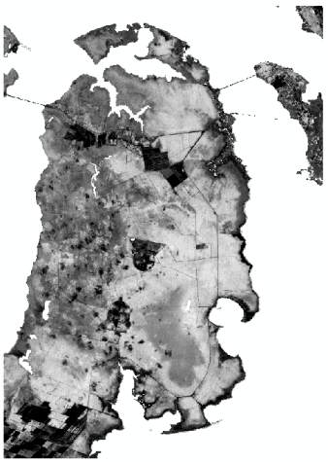
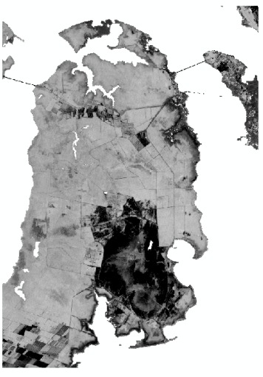
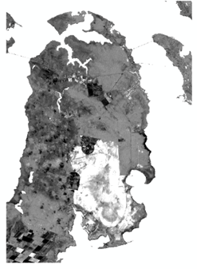
differenced Normalized Burn Ratios
differenced Normalized Burn Ratio (dNBR): assesses burn severity using pre-fire and post-fire images
Raw Data (bands 4 and 7) from the Landsat imagery will need to be converted to radiance and reflectance for pre- and post-fire images. This can be done using the DN to Reflectance model in ArcMap 10.
NBRs will be calculated in Raster Calculator using Equation 1 for pre- and post-fire images using the reflectance values.
Equation 1:
NBR= FLOAT (Band 4-Band 7)/(Band 4 + Band 7)
dNBRs will be calculated by using Equation 2: dNBR= FLOAT (pre-fire NBR)-(post-fire NBR)
Thresholds for classifying regrowth, unburned, and low to high burn severity will be determined by the user. The color ramp may also be changed to highlight areas of regrowth and severe burns.
Pre-fire NBR for Pains Bay
Post-fire NBR for Pains Bay
dNBR for Pains Bay

Slide 24
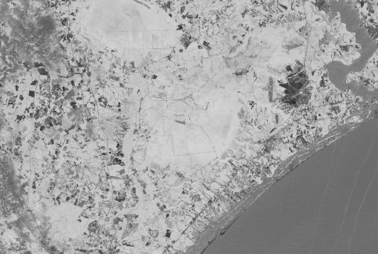
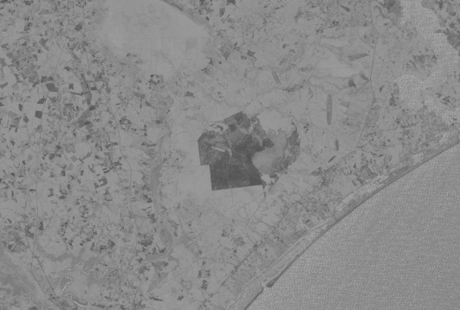
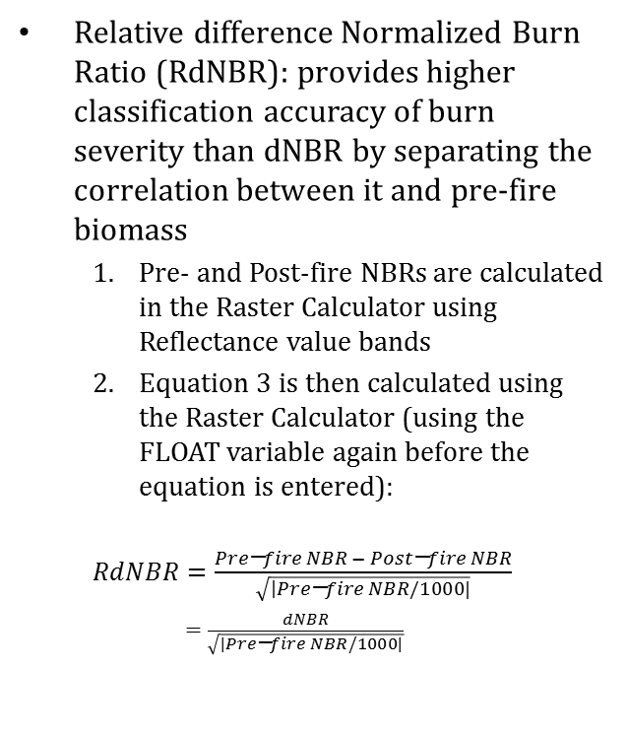
Relative difference Normalized Burn Ratio
Relative difference Normalized Burn Ratio (RdNBR): provides higher classification accuracy of burn severity than dNBR by separating the correlation between it and pre-fire biomass
Pre- and Post-fire NBRs are calculated in the Raster Calculator using Reflectance value bands
Equation 3 is then calculated using the Raster Calculator (using the FLOAT variable again before the equation is entered):
$RdNBR=\frac{Pre\text{−}fire NBR − Post\text{−}fire NBR}{\sqrt{\left|Pre\text{−}fire NBR/1000|\right.}}$
$=\frac{dNBR}{\sqrt{\left|Pre\text{−}fire NBR/1000\right|}}$
Pre-fire NBR
Post-fire NBR
Juniper Road Fire RdNBR
Notes:
Cropped to burn perimeter.

Slide 25
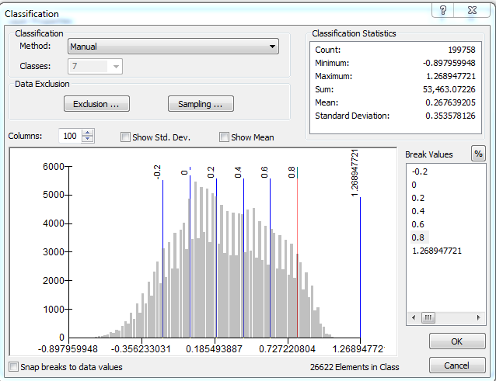
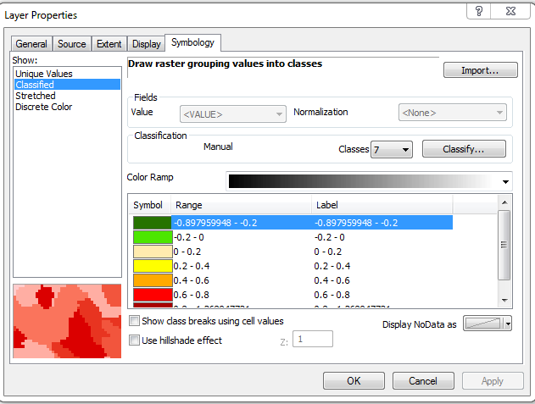
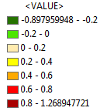
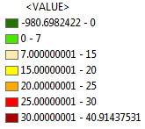
Classifying dNBRs and RdNBRs
After creating the dNBR or RdNBR, you should classify the image to better distinguish the levels of regrowth to high burn severity.
To create the classes, right click on the dNBR or RdNBR in the Table of Contents and click Properties. Click on the Symbology tab -> Classified (Click “Yes” to compute histogram) -> Classify -> Quantile (From the Method drop down menu) -> Change classes to 7 -> Click on values under “Break Values” to change the class limits to appropriate values. Click OK.
Change the colors to represent the different classes. Click OK.
dNBR scale
Note: Beginning and ending values are subject to change based on the lowest and highest value in your dNBR or RdNBR.
RdNBR scale

Slide 26
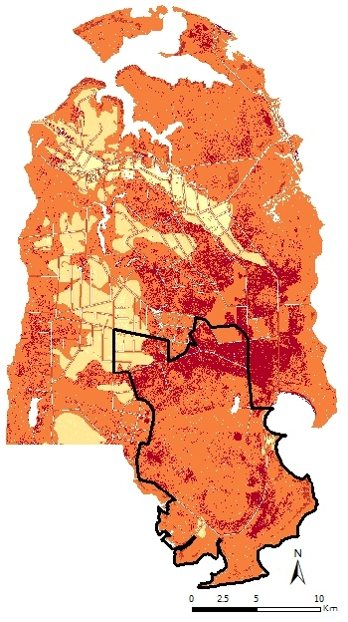
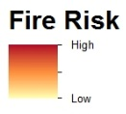
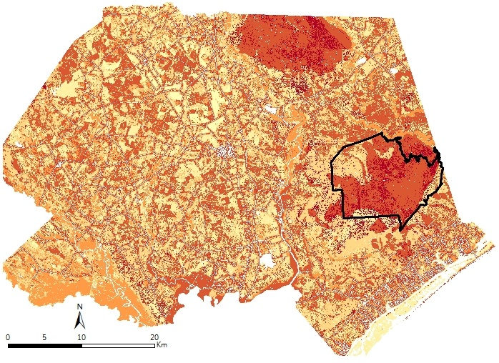
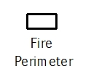
Fire Risk Maps
We included five variables into the fire risk maps.
Ideally, you can choose however many variables that you feel apply to fire risk variables
Each variable chosen must be normalized into a similar scale in order to be compared to one another

Slide 27
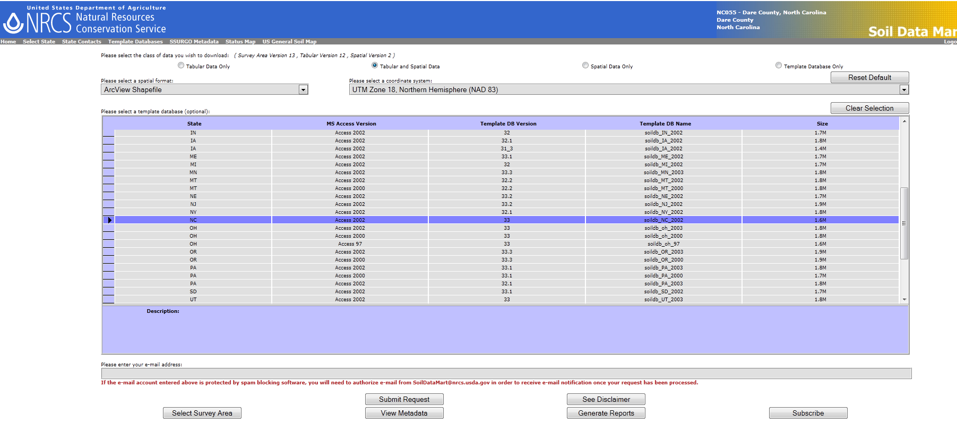
Fire Risk Maps: Soil Types
To access Soil Survey Data, navigate to: http://soildatamart.nrcs.usda.gov/
Click Select State. Click the state you wish to download, i.e. North Carolina.
Click Select County. Click the county you wish to download. Click Select Survey Area.
On the next screen, click Download data.
Enter your e-mail address in the Please enter e-mail address window and click Submit Request.
While waiting for the data to be delivered, repeat Steps 2 through 5 to download multiple counties.
Once delivered, open the layers in ArcGIS 10 and reproject the layers using the Project tool into a common projection system. For this study, we used WGS 84 UTM Zone 18N.
Once reprojected, merge the layers into the Master_Soil layer by using the Merge tool.

Slide 28
Fire Risk Maps: Soil Types
Each county has various soil types and soil names. Use the resources on the Soil Data Mart website in order to be able to reclassify the soil names into soil families
For example, the soil families that exist in Dare and Pender counties are Alfisols, Entisols, Histosols, Inceptisols, Spodosols, and Ultisols.
Each polygon must be classified into a soil family. Open the attribute table of the Master_Soil Layer. Click Table Options from the top menu bar, then click Add Field.
Name the new field Soil_Code, change the Type to float Float. Click OK.
Select all the appropriate polygon for one soil family, for example Histosols. Then, click the Show Selected Records icon at the bottom of the screen.
Right-click the heading Soil_Code, then click Field Calculator. Insert the new code integer for each soil family. See table below.
For example, all Histosols should get the code 3.
All polygons that are not a soil type (for example, water) should be classified as 0.
Once all families have been coded, click Geoprocessing from the top menu bar, then click the Dissolve tool.
Insert Master_Soil as Input Features.
Redirect the Output Feature Class to your working space and name the dissolved
image as Master_SoilFam.
Check the box next to Soil_Code in the Dissolve_Field(s) window.
Soil Family | Soil_Code
Alfisols | 1
Entisols | 2
Histosols | 3
Inceptisols | 4
Spodosols | 5
Ultisols | 6

Slide 29
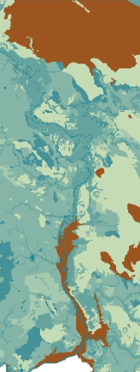
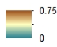
Fire Risk Maps: Soil Types
Once the new layer is dissolved, open the attribute table to verify that one polygon exists for each the Soil_Code value.
If completed, add a new field in the attribute table called Weight, and change the type to Float (as you did in Step 10).
Establish a weight between 0 to 100 for each soil class based on its combustibility.
For example, we gauged combustibility for each soil type based on historical ground fires and organic content. Refer to table below for example of weight values chosen.
All non-soil type categories remain the value of 0.
Open ArcToolbox, navigate to the following tool: Conversion Tools→To Raster→Polygon to Raster.
Insert the Master_SoilFam into the Input Features.
Change the Value Field to Weight.
Navigate the Output Raster Dataset to your working folder and name the file Soil_Raster.
Input 30 into the Cellsize window. Leave all other defaults. Click OK.
Open ArcToolbox, navigate to the following tool: Spatial Analyst Tools→Map Algebra→Raster Calculator.
The equation should read: Float(“Soil_Raster”*0.01)
Navigate the Output Raster to your working folder.
Name the final image Soil_Variable.
Soil Family | Soil_Code | Weight
Alfisols | 1 | 20
Entisols | 2 | 10
Histosols | 3 | 75
Inceptisols | 4 | 5
Spodosols | 5 | 25
Ultisols | 6 | 15
The soil layer now has membership and will be used in the Fuzzy Overlay after the other layers have been completed.

Slide 30
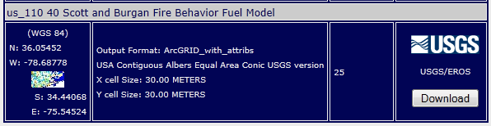
Fire Risk Maps: Fuel Cover
To access LANDFIRE Data, navigate to: http://landfire.cr.usgs.gov/viewer/
Click zone 58 for the Coastal Plains Region of North Carolina.
Click the globe icon in the upper left-corner, and click Download Data.
In the Download Data window on the right, expand the LF2008 (Refresh – LF_110) category, followed by the Fuel category.
Check the box next to the layer us_110 40 Scott and Burgan Fire Behavior Fuel Model, i.e. the first option in the listing.
Click the Define Rectangular Download Area for Seamless Data and draw a box around the study area.
In the new window, click the Download button next to the layer titled us_110 40 Scott and Burgan Fire Behavior Fuel Model.
Open this new raster layer in ArcGIS 10, and project into WGS 84 UTM Zone 18N using Project Raster. Name the output raster as FBFM40_18N.
Make sure to download all necessary tiles to cover your study area. For this study, both Dare and Pender counties are within the same USGS tile.

Slide 31
Fire Risk Maps: Fuel Cover
Before the weights can be calculated, the layer needs to be scaled to the study area.
To access a County shapefile for North Carolina, navigate to: http://www.ncdot.gov/it/gis/DataDistribution/DOTData/
Download the County Boundaries for the state.
Open this new layer in ArcGIS 10, and open the Select by Attributes tool from the Selection tab in the menu bar.
Enter the expression: "NAME" = 'DARE' OR "NAME" = 'PENDER‘
Click OK.
Right-click the county layer and navigate to Selection→Create Layer From Selected Features.
Reproject the new layer of the selected counties into WGS 84 UTM Zone 18N using the Project tool. Name the output: Cntys_18N.
Open the Polygon to Raster tool and insert the Cntys_18N layer as Input Feature.
Leave the defaults for the Cell assignment type and Priority Field.
Set the Value Field to FIPS.
Navigate the Output Raster Dataset to your working folder, and name the image: Cntys_Rast.
Set Cellsize to 30.
Click Environments. Click Processing Extent, and navigate the Extent to the Soil_Variable layer created earlier. Click OK twice.
Open the Reclassify tool, and set the input raster to Cntys_Rast.
The old values are the previous FIPS numbers. The New Values should all be set to 1. Leave NoData as NoData.
Name the Output Raster as Cnty_Bool.
Open the Raster Calculator tool, and input the following expression: Float(“Cntys_Bool”*” FBFM40_18N”).
This step isolates the fuel types within our two counties and eliminates surrounding counties.
Name the Output Raster as Fuel_StyArea.

Slide 32
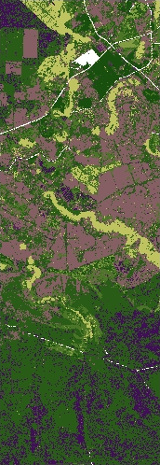
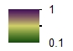
Fire Risk Maps: Fuel Cover
Open the attribute table of FBFM40_18N and take note of the FBFM40 column which gives a USGS fuel code for various land cover types. Use the help material on the LANDFIRE website to give a detailed description of each of these categories to be able to assign appropriate weights. Open the Properties of Fuel_StyArea layer, and click Unique Values to compute the values.
Open the Reclassify tool, set the Input Raster to Fuel_StyArea. Enter the new weight values in the New Values column. See the table below for our chosen weights. Set the Output Raster to your working folder and name the layer Fuel_weight.
Open Raster Calculator, then enter the following expression: Float(“Fuel_Weight”*0.01)
Navigate the Output Raster to your working folder.
Name the final image Fuel_Variable.
The fuel layer now has membership and will be used in the Fuzzy Overlay after the other layers have been completed.
FBFM40 | NB1 | NB3 | NB8 | NB9 | GR1 | GR2 | GR3 | GR5 | GS1 | GS2 | GS3 | SH1 | SH2 | SH3 | SH4 | SH7 | SH8 | SH9 | TU1 | TU2 | TU3 | TL1 | TL2 | TL3 | TL5 | TL6
Value | 91 | 93 | 98 | 99 | 101 | 102 | 103 | 105 | 121 | 122 | 123 | 141 | 142 | 143 | 144 | 147 | 148 | 149 | 161 | 162 | 163 | 181 | 182 | 183 | 185 | 186
Weight | 0 | 10 | 0 | 0 | 25 | 15 | 15 | 20 | 35 | 75 | 75 | 25 | 25 | 25 | 25 | 90 | 95 | 100 | 25 | 35 | 75 | 25 | 25 | 25 | 25 | 50

Slide 33
Fire Risk Maps: Proximity to Roads
To access NCDOT Data, navigate to: http://www.ncdot.gov/it/gis/DataDistribution/DOTData/
Click to download the ISRN Zip File, which is the Integrated Statewide Road Network.
Open this layer in ArcGIS 10, then reproject the layer into WGS 84 UTM Zone 18N using the Project tool. Call the output Roads_18N.
Open the Dissolve tool from the Geoprocessing menu bar.
Set the Input Features to Roads_18N.
Navigate the Output Feature Class to the working folder and label the new layer as All_Roads.
Open the Clip tool from the Geoprocessing menu bar.
Set the Input Features as All_Roads.
Set the Clip Features to Cntys_18N.
Set the Output Features to your working folder, and label the layer as Roads_StyArea.
Open ArcToolbox, navigate to Conversion Tools→To Raster→Feature to Raster.
Set the Input Feature to Roads_StyArea.
Set Field to FID.
Set the Output Raster to your working folder and label the layer as Roads_Rast.
Set Cellsize to 30.
Click Environments. Click Processing Extent, and navigate the Extent to the Soil_Variable layer created earlier. Click OK twice.
Open the Reclassify tool, and reclass all old values to the new value of 1. Leave NoData as NoData. Label the Output Feature as Road_Master.
Open the Reclassify tool again, and reclass all old values of 1 to NoData and the old value of NoData to the new value of one1. Label the Output Feature as Road_Bool. (This layer will be used in a step to follow.)

Slide 34
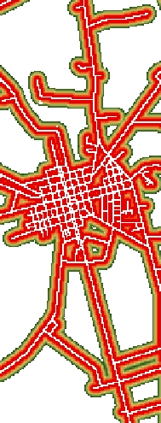
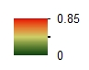
Fire Risk Maps: Proximity to Roads
To calculate distance from roads, navigate to the following tool: Spatial Analyst Tools→Distance→Euclidean Distance.
Set Input raster of feature source data to Road_Master.
Set Output distance raster to your working folder, and label the layer as Roads_Dist.
Leave all other defaults. Make sure the Output Cell Size is set at 30. Click OK.
Open Raster Calculator, then input the following expression: Float(“Roads_Dist”*”Roads_Bool”*” Cntys_Bool”).
Set Output raster to your working folder, and label the layer as Dist2Roads.tif.
To apply membership, open ArcToolbox and navigate to the following tool: Spatial Analyst Tools→Overlay→Fuzzy Membership.
Set Input Raster to Dist2Roads.tif.
Set the Output Raster to your working folder, and label this layer as Roads_Variable.
Set the Membership Type to Linear.
Set the Minimum to 200 and the Maximum to 30. Click OK.
The roads layer now has membership and will be used in the Fuzzy Overlay after the other layers have been completed.

Slide 35
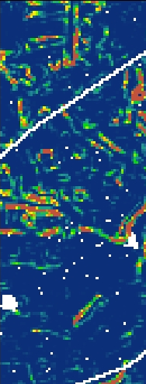
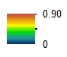
Fire Risk Maps: Slope
Open the ASTER Global DEM products that were downloaded at the beginning of the tutorial into ArcGIS 10. There are three tiles for this study.
Navigate to the following tool in ArcToolbox: Data Management Tools→Raster→Raster Dataset →Mosaic To New Raster.
Input all DEM layers. Set Output Location to your working folder.
Set Raster Dataset Name with Extension to DEM_all.tif.
Set Number of Bands to 1. Leave all other defaults.
Open Raster Calculator and input the following expression: Float("DEM_all" *”Cntys_Bool”).
Set Output raster to your working folder, and label the layer as DEM_Sty.tif.
Reproject DEM_Sty.tif into WGS 84 UTM Zone 18N, and label this layer as DEM_Sty18N.tif using the Project Raster tool.
Navigate to the following tool in ArcToolbox: Spatial Analyst Tools→Surface→Slope.
Set the Input Raster as DEM_Sty18N. Set the Output Raster to your working folder and label this layer as Slope_Perc.
Set the Output Measurement as Percent. Set the Z factor as 0.5. Click OK.
To apply membership, navigate to the Fuzzy Membership tool.
Set Input Raster to Slope_Deg. Set the Output Raster to your working folder, and label this layer as Slope_Vari1.
Set the Membership Type to Large. Leave the default midpoint value. (Alter this value in order to get various results for membership.)
Open Raster Calculator and input the following expression: Float(“Slope_Vari1" *”Roads_Bool”).
Set Output raster to your working folder, and label the layer as Slope_Variable.
The slopes layer now has membership and will be used in the Fuzzy Overlay after the other layers have been completed.

Slide 36
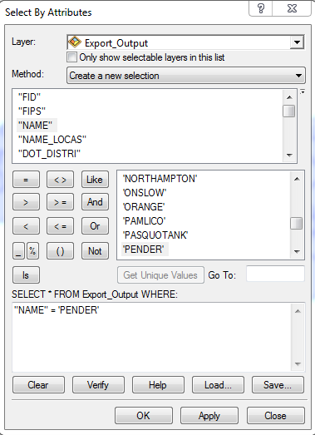
Fire Risk Maps: Wildland-Urban Interface (WUI)
Wildland Urban Interface maps help show where urban areas are within a county and where these areas come in contact with wildland areas that are at risk for fire. To make these maps:
Download the County Boundaries shapefile from the Boundary Data section at http://www.ncdot.gov/it/gis/DataDistribution/DOTData/
Add both the shapefile and a raster dataset of your study area to ArcMap 10
To clip the image to your exact study county, click Selection in the upper right side of the page -> Select by Attributes -> In the pop-up window, ensure the shapefile name is in the layer drop down box -> Double-click “NAME” in the Method window -> Click the “=“ -> Click “Get Unique Values” to add the county names -> Select the county of interest (We used Pender.) -> Click OK.

Slide 37
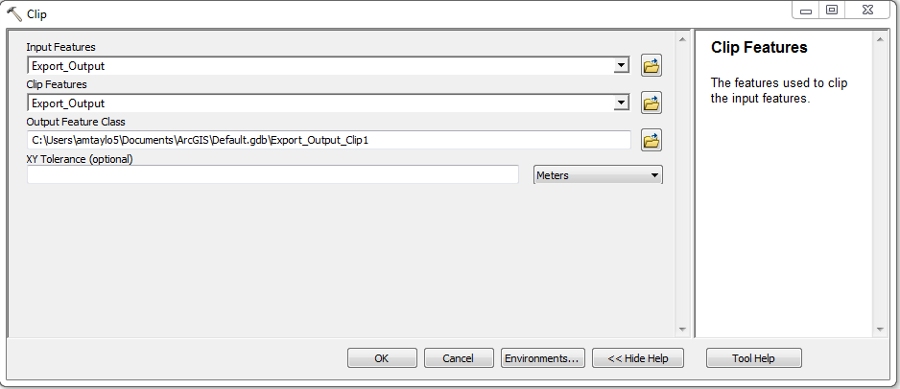

To clip out just your study county: Click Geoprocessing in the upper right side of the page -> Click the “Clip” tool -> In the pop-up window, click the North Carolina counties shapefile for both the Input tab and the Clip Features tab -> Save the output file -> Click OK
North Carolina counties
shapefile
**You should have an outline of just your county of interest.
To clip your raster dataset to your county of interest, Open Arc Toolbox -> Click Spatial Analyst -> Click Extraction -> Click Extract by Mask
In the pop-up window, put your raster dataset in the Input raster tab and the outline of the county you just made in the Input raster or feature mask data tab. Save your output raster, and click OK.
**You are now ready to use the image to create the WUI map.
To distinguish between urban and non-urban areas, open Arc Toolbox -> Click Spatial Analyst -> Click Multivariate -> Click Iso Cluster Unsupervised Classification -> Input your raster dataset in the Input raster bands window -> Set an arbitrary number of classes (We used 5.) ->Save output file and keep all other areas set to default. -> Click OK.

Slide 38

Using Google Earth as a reference, you can distinguish between the classes and determine which areas are urban and which are not.
**Note: It’s helpful to assign one color for urban areas and no color for other areas.
To ensure accuracy, you can overlay your unsupervised classification map onto the Google Earth image of your study area and confirm the colored areas are urban. To do this convert the layer to a KML file (Arc Toolbox -> Conversion Tools -> To KML -> Layer to KML). In the pop-up window, put your latest layer into the Layer tab, save your Output File, and set a Layer Output Scale (we used 20,000).
**If the colored areas correspond to only urban areas, the map is ready to be used. If not, proceed to the next slide.

Slide 39

If Unsupervised Classification classifies non-urban areas as urban areas, the classification must be done manually. This can be done by creating polygons around the urban areas in Google Earth.
**Note: Be sure to draw the polygons as close to the property lines and buildings as possible for accuracy.
Once all polygons are made, they can be converted back to layer files in QGIS (Quantum GIS is a free GIS software available online). QGIS must be used to convert the KML files back to layer files because ArcGIS 10 has a glitch in this tool.
Create New Polygon

Slide 40



Download the QGIS software from: http://www.qgis.org/
After opening the program, click “Layer” → “Add Vector Layer”
Leave the Source Type settings to default. Browse to where your KML layers are located, then open them in QGIS
When the layer is displayed, right click on the name under the Layers tab and click “Save as”
Keep the Format as ESRI Shapefile. Select “Browse” to select where your shapefile will be saved and what you will name it. Leave all other settings at their default, and then click OK.
Your KML has now been saved as a shapefile and is ready to be added to ArcGIS using the “Add data” button on the toolbar.
Add all of the KMLs you created into ArcGIS, and then use the Merge tool (Toolbox → Data Management → General → Merge) to make them one shapefile.
Under “Input Datasets”, add all of your individual layers.
Name and set your output data set name and location, and leave the Field Map section alone.

Slide 41

Once all KML layers have been merged, you will need to dissolve them together using the Dissolve tool (Toolbox → Data Management → Generalization → Dissolve).
The input feature is the layer you just created from your merge. Set and name the Output as desired. Leave the other sections alone, and click OK.
Finally, your dissolved layer needs to be reprojected to the proper coordinate system (as referenced previously in the tutorial)
See next slide to learn how to incorporate this into the fire risk map.

Slide 42


Fire Risk Maps: WUI
Open the dissolved polygon shapefile, and add a new field in the attribute table called Urban with the type set to Float.
Right-click the Urban heading in the attribute table, select Field Calculator, set the value to 1, and then click OK.
Open the Polygons to Raster tool, and input the dissolved urban feature shapefile.
Set the Output Raster to your working folder, and label the layer as Urban_Raster.
Set the Value Field to Urban. Set Cellsize to 30.
Click Environments. Click Processing Extent,. Navigate the Extent to the Soil_Variable layer. Click OK twice.
Open the Reclassify tool, and reclass all old values of 1 to NoData and the old value of NoData to the new value of 1. Label the Output Feature as WUI_Bool. (This layer will be used in a step to follow.)
Navigate to the Euclidean Distance, and set Input raster of feature source data to Urban_Raster.
Set Output distance raster to your working folder, and label the layer as WUI_Dist.
Leave all other defaults. Make sure the Output Cell Size is set at 30. Click OK.
Open Raster Calculator, then input the following expression: Float(“WUI_Dist”*”WUI_Bool”*” Cntys_Bool”).
Set Output raster to your working folder, and label the layer as Dist2WUI.tif.
Navigate to Fuzzy Membership, and set Input Raster to Dist2WUI.tif.
Set the Output Raster to your working folder, and label this layer as WUI_Variable.
Set the Membership Type to Linear. Set the Minimum to 200 and the Maximum to 30. Click OK.
The WUI layer now has membership and will be used in the Fuzzy Overlay after the other layers have been completed.

Slide 43
Fire Risk Maps: Overlay Variables
Open the ArcMap, add all the final variables: Soil_Variable, Fuel_Variable, Roads_Variable, Slope_Variable, and WUI_Variable.
All variables should have the following similarities:
Same extent window that encompasses both counties
Spatial resolution of 30 meters.
All in the coordinate system of WGS 84 UTM Zone 18N
All should be on the same scale of zero to one, where one represents the greatest fire risk
Navigate to the following tool: Spatial Anaylst Tools→Overlay→Fuzzy Overlay.
Input all the variables into the Input Rasters window.
Save the final risk map to your working folder.
Change the overlay type to OR. Click OK.
NOTE: It is strongly encouraged to read all of the help material on ArcGIS 10 Desktop Help online (http://help.arcgis.com/en/arcgisdesktop/10.0/help/index.html#/What_is_ArcGIS_Desktop/00v200000005000000/). There are five types of Fuzzy Overlay, which are all described in detail on ArcGIS 10 Desktop Help. We also encourage you to run each type of overlay to understand how various modeling techniques effect the outcome.

Slide 44
Fire Risk Maps: Evaluating Pre and Post Fuel Load
We looked at an alternative method to the solely depending on the LANDFIRE fuel map to get a better understanding of the fuel load before and after the fire at each location.
For the pre-fire fuel fire risk, we used the clearest Landsat 5 images for both fire extent sites: 06/19/11 for the Juniper road fire and 02/20/11 for the Pains Bay Fire.
Both images were atmospherically corrected (refer to Slide 10), reprojected into WGS 84 UTM Zone 18N using the Project Raster tool, and an NDMI was calculated for both (refer to Slide 13).
Using the Juniper Roads Fire an example, we first needed to correct for error and normalize the data to be comparable to the Fuel_Variable. The NDMI image of the study area was then reclassified using the Reclassify tool.
Set the Input Raster to Juniper_NDMI.tif (i.e. the NDMI image of the Juniper Road Study Area).
Set the Reclass field to Value.
Click the Classify button, change the Classes to 3, and change the Break Values to -1 and 1. Click OK.
You should have three classes shown.
All values less than -1 should have the new value of NoData.
All values between -1 to 1 should have the value of 1.
All values greater than 1 should have the new value of NoData.
All values of NoData should remain NoData.
Save to your working folder and label this layer as Juni_bool.tif.
Open Raster Calculator and enter the expression: Float(“Juni_bool”*”Juniper_NDMI”).
Set output to your working folder and label the new layer as Juniper_NDMI2.tif.

Slide 45
Fire Risk Maps: Evaluating Pre and Post Fuel Load
Open Raster Calculator and enter the expression: Float(“Juniper_NDMI2”*-1).
Set output to your working folder and label the new layer as Juniper_NDMI_reverse.tif.
Open Raster Calculator and enter the expression: Float(“Juniper_NDMI_reverse”+1).
Set output to your working folder and label the new layer as Juniper_NDMI_reverse_pl1.tif.
Open Raster Calculator and enter the expression: Float(“Juniper_NDMI_reverse_pl1”/2).
Set output to your working folder and label the new layer as Juniper_NDMI_normalized.tif.
Open Raster Calculator and enter the expression: Float(“Juniper_NDMI_normalized”+“Fuel_Variable”).
Set output to your working folder and label the new layer as Juniper_Fuel_NDMI.tif.
Open Fuzzy Membership and set the Input raster as Juniper_Fuel_NDMI.
Set output to your working folder and label the new layer as Juniper_prefire_Fuel.tif.
Set the Membership type to Linear. Make sure the Minimum value is the minimum value. The same for the Maximum value. Click OK.
For the post-fire fuel fire risk, create (or use) the RdNBR for the Juniper Road Fire (refer to Slide 24). Open Fuzzy Membership and set the Input raster as Juniper_RdNBR.tif (i.e. the RdNBR image for the Juniper Road Fire).
Set output to your working folder and label the new layer as Juniper_postfire_Fuel.tif.
Set the Membership type to Linear. Make sure the Minimum value is the minimum value. The same for the Maximum value. Click OK.
Repeat the following steps for all study areas.
Note: See next slide for image of the results after color ramps have been applied.

Slide 46


Fire Risk Maps: Evaluating Pre and Post Fuel Load
The above images have been scaled down to the extent of the fires. Please follow the previous Boolean methods that have been described throughout the tutorial. (A good example of the technique can be read on Slide 31.)

